Slide 1
Welcome to U-Multirank –
an introductory webinar for participants from Ukraine
September 2019

Slide 2
Content
How does U-Multirank differ from other international university rankings?
The time schedule of U-Multirank
The surveys (pre-, institutional, subject & student survey)
The data collection process
Questions so far
How does the Ukrainian university environment translate into U-Multirank? (Kateryna Suprun)
Final questions

Slide 3
Key charactieristics of UMR
Not limited to international research universities
Diversity of HEIs
No league table
Multi-dimensional ranking
No composite score,
no weights on indicators
Ranking in 5 categories per indicator
More encompassing than institutional information
Comprehensive subject rankings
3
Notes:
So to give you a brief overview of the key characteristics of UMR
UMR emphasises particularly the diversity of HEIs which is expressed by its ranking in 5 dimensions at institutional as well as at subject level
These 5 dimensions are: teaching & learning, research, knowledge transfer, international orientation, regional engagement;
(instead, we do top 25 performers for selected indicators)
In our 2019 edition, we cover
about 1.700 HEIs from 96 countries
About 5.000 departments with 12.000 study programmes
Feedback from more than 100.000 students
23 subjects

Slide 4
Project development of
2014 | 2015 | 2016 | 2017 | 2018
850 universities | 1.200+ universities | 1.300+ universities | 1.500 universities | 1.600+ universities
4 subjects | 7 subjects | 13 subjects | 16 subjects | 21 subjects
60,000 student survey replies | 85,000 student survey replies | 105,000 student survey replies | 150,000 student survey replies | 150,000+ student survey replies

Slide 5
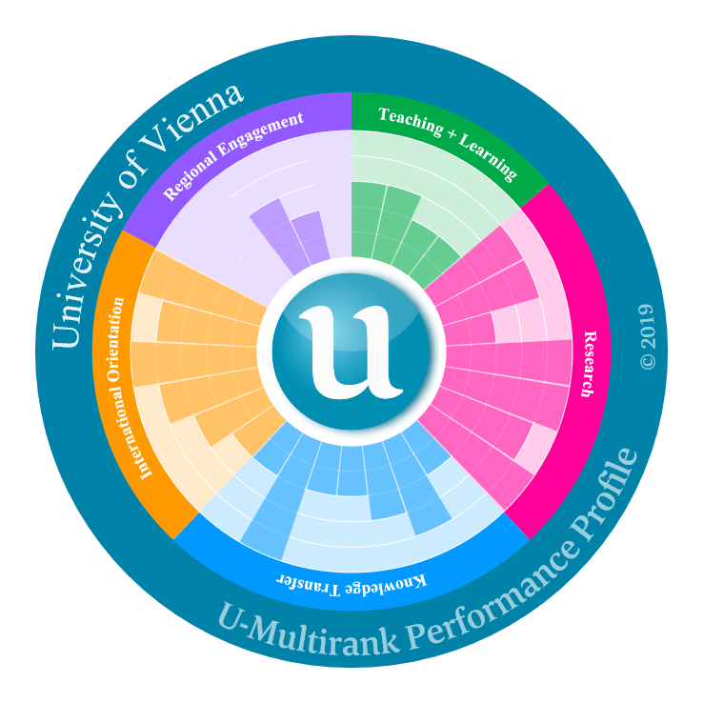
5 dimensions show a university‘s profile
Teaching & Learning
Research
International Orientation
Knowledge Transfer
Regional Engagement

Slide 6
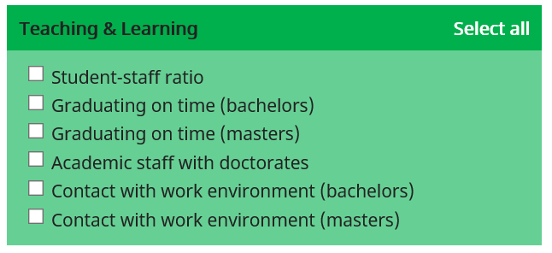
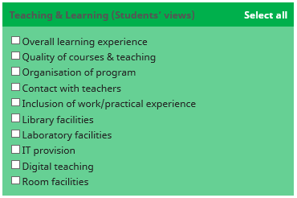
Die Indikatoren

Slide 7
Schedule
Registration U-Multirank (UMR) 2020 |  |  | March - September 2019
Pre-Survey |  |  | June - September 2019
Institutional survey 1st data delivery 2nd data delivery | Subject survey 1st data delivery 2nd data delivery | Student survey | September - December 2019
Verification of data & final queries by UMR
Calculation of indicators |  |  | January-February 2020
"Participant package" sent to data co-ordinators |  |  | April 2020
Publication of U-Multirank 2020 |  |  | June 2020

Slide 8
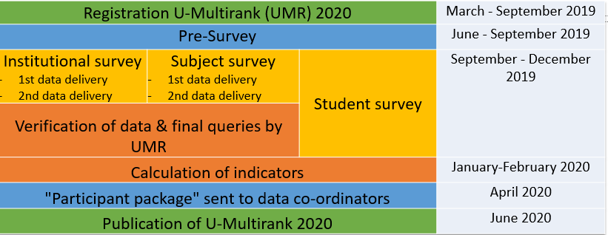
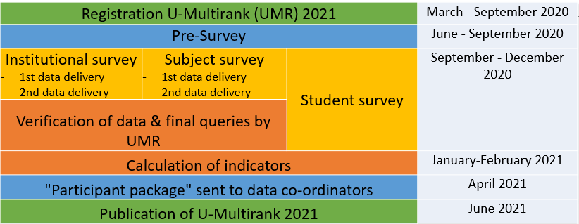
Schedule
Overlap: U-Multirank 2019 and
U-Multirank 2020

Slide 9
Subjects for the 2020 publication
New subjects:
Earth Science/ Geology
Social Geography
International Law
Linguistics
Subject updates:
Business Studies
Economics
Educational Sciences
History
Political Science
Sociology

Slide 10
Registration for Ukrainian participants
Deadline: 16 September 2019

Slide 11
The surveys: Pre-Survey (compulsory)
Start: end of June 2019
Deadline: 30 September 2019 for Ukrainian universities
Content: Contact data, student numbers, university picture (, if participating in subject rankings: Departments/Faculties/Schools and participating study programmes).
Registration of subjects and degree programmes for subject rankings
➔ Submission prerequisite for participation in institutional & subject rankings

Slide 12
The surveys: Institutional Survey (compulsory)
Running: July – December 2019
Start: individually, depending on date (and completeness) of submission of pre-survey
One questionnaire per institution
Content: All data at institutional level (profile of institution, students, staff, graduates, revenues, …)
Two phases of data collection/submission (see slide 14):
1st deadline: 8 weeks after start

Slide 13
The surveys: Subject Survey (voluntary)
Running: July – December 2019
Start: individually, depending on date (and completeness) of submission of pre-survey
One questionnaire per department and subject
Content: All data at subject level (students, graduates, staff, revenues, profile of programmes, …)
Two phases of data collection/submission (see slide 14):
1st deadline: 8 weeks after start

Slide 14
The surveys: Student Survey (voluntary)
Linked to subject rankings, i.e. only students from the 2020 subject areas may be included
Sample: Up to 500 students per subject and department (both bachelor and master students; or equivalent programmes)
Invitation to students has to be sent by institutions (by email); UMR will provide all documents/materials and a manual
Minimum response to be take in: 15 students per subject in absolute numbers and 10% of the sample
Institutions will receive a detailed analysis of the results of their own students compared to the total sample in the subject

Slide 15
The surveys: Comon feedback loops in data collection
Several feedback loops are included to assure the quality of data:
Built-in checks in institutional and subject questionnaire: Automated warnings pop-up in case of implausible or inconsistent data
After 1st data submission, data are verified by U-Multirank and comments and questions are inserted into the questionnaire (“Comments U-Multirank”)
This is followed by a 2nd period of data collection: institutions can verify and/or correct their data according to our questions and can complete data
After 2nd data submission, data are checked again and institutions are contacted individually by email regarding open questions

Slide 16
The data collection process
Access points to all surveys with direct links to questionnaires
Plus access to results (three weeks prior to publication)

Slide 17
General questions
In which languages are the questionnaires available?
The institutional and the subject survey are available in English
The student survey is available in Chinese, English, French, German, Greek, Italian, Spanish, Persian, Polish, Romanian, Russian and Ukrainian.
How and when can we obtain the password in order to access the U-Multirank platform for data collection?
We send you the institutional password in your invitation to the pre-survey.
Who decides which programmes will be included in U-Multirank subject ranking?
The institutions decide in the first step (pre-survey) which of their study programmes out of the subject areas examined in 2019 (published in 2020) they wish to have included in U-Multirank. The U-Multirank Team will check the study programmes (no programmes < 10 students, no PhD programmes, programmes must belong to the examined subject areas).

Slide 18
Questions ?

Slide 19
National specifics: subject ranking
U-Multirank subjects | National study fields and specialties
Biology | 091 Біологія
Business Studies | 07 Управління та адміністрування
Chemical Engineering | 161 Хімічні технології та інженерія
Chemistry | 102 Хімія
Civil Engineering | 192 Будівництво та цивільна інженерія
Computer Science & Engineering | 122 Комп’ютерні науки 123 Комп’ютерна інженерія
Dentistry | 221 Стоматологія
Economics | 051 Економіка
Education | 01 Освіта/Педагогіка
Electrical Engineering | 14 Електрична інженерія
History | 032 Історія та археологія
Industrial Engineering/Production | 18 Виробництво та технології (крім 183 Технології захисту навколишнього середовища)
Linguistics | 035 Філологія
U-Multirank subjects | National study fields and specialties
Mathematics | 111 Математика
Mechanical Engineering | 13 Механічна інженерія
Medicine | 222 Медицина
Nursing | 223 Медсестринство
Pharmacy/Pharmacology | 226 Фармація, промислова фармація
Political Sciences | 052 Політологія
Psychology | 053 Психологія
Social Work | 231 Соціальна робота
Sociology | 054 Соціологія
Environmental Engineering | 183 Технології захисту навколишнього середовища
Materials Engineering | 132 Матеріалознавство
Earth Science/ Geology | 103 Науки про Землю
Social Geography
International Law | 293 Міжнародне право
Reference sources:
http://uis.unesco.org/sites/default/files/documents/international-standard-classification-of-education-isced-2011-en.pdf
https://zakon.rada.gov.ua/laws/show/266-2015-%D0%BF

Slide 20
National specifics: important terms
Graduation on time
Retention rate
Post doc - assistant professors and lecturers
Short cycle - NQF level 6, Junior Bachelor Degree (90-120 ECTS)
Residency - left out for the degree programmes offer, calculated for the total number of graduates
Professional publications - not referenced in Scopus or published in non-indexed impact-factor journals
Updated NQF (2019)

Slide 21
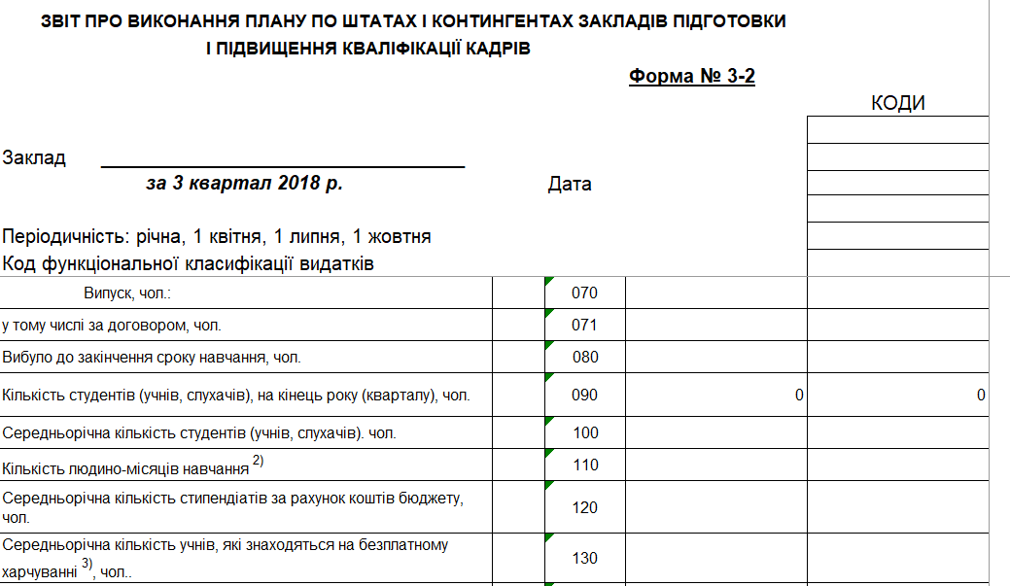
National specifics: data sources
Unified State Electronic Education Database (ЄДЕБО)
Employment Data
Regional Engagement
State Treasury Service of Ukraine (ДКСУ)
National Graduate Tracking System (in development)
Institutional strategies, partnership/project agreements

Slide 22
Questions received:
What do you mean by „unit“:
in the pre-survey, unit refers to the departments/faculties/schools with which you plan to participate in the subject survey;
in the subject & institutional survey, unit refers to the measurement of your third party funding: are you indicating in full amounts, in thousands or in million
What to do if data are not available?
If data are not available for 1st deadline, please leave a comment that “data are not available” and submit them by the 2nd deadline; if possible, student and staff data should be submitted for the first deadline
If data for certain questions are not available, please leave those fields blank and tick the "data not available" box. Please enter "0" (zero) only if zero is the correct value!
Which indicators does UMR evaluate? Explanations on data elements, calculations and rationales can be found in the indicator book on our website.

